Slide 1
GCSE Business Studies
Notes:
What do you already know about Business Studies?
TV programmes - The Apprentice, Dragons den, Mary Portas in Mary Queen of Shops or Secret Shopper
Documentaries like Inside Apple, John Lewis or Primark show you what Businesses involve
If you are interested in these kind of programmes, BS might be for you

Slide 2
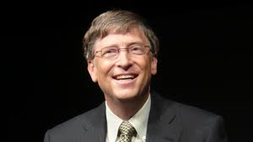
Are you familiar with these people? Could you match the person to their business logo?

Slide 3
The solution…

Slide 4
What is Business?
Think about that new top or new pair of trousers you bought last week and then consider what businesses made it possible for you to wear it?

Slide 5
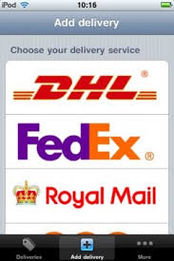
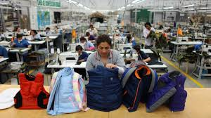
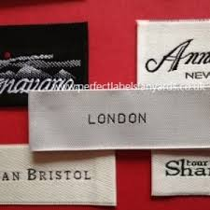
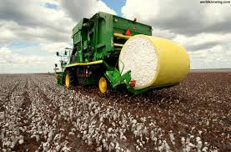
What businesses were involved in your purchase?
Notes:
Think about that new top or new pair of trousers you bought last week and then consider what businesses made it possible for you to wear it?
the Shop
the Factory
the Delivery company
the cotton producer
the label maker
the packaging company
Health & Safety law and the government
the Accountancy firm that manages the finances of the firm
Investigating all those processes and the people involved allows you to begin to understand what Business Studies is all about.

Slide 6
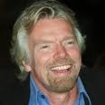
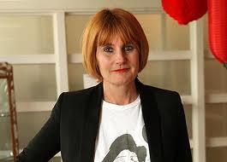
Everything in life involves Business
It is in the news
It is on TV
You will all go on to work in places that will be affected by the issues we cover
You will all be consumers
Some of you may even go on to be Entrepreneurs or run companies…
Notes:
Business is a major part of everyone’s life and anybody who has a good idea about how businesses work are at an immediate advantage in the future

Slide 7
GCSE Business Studies:
Paper 1: Influences of operations and HR on business activity
(1 hour 45)
Business in the real world
Influences on business
Business Operations:
Production methods and deciding if there is a more efficient way to run the business
Human resources:
Managing staff, improving their skills, and motivating them. The law.
Paper 2: Influences of marketing and finance on business activity
(1 hour 45)
Business in the real world
Influences on business
Marketing:
How to persuade people to buy your products
Finance:
How businesses work out their finances
Cash flow, Profit & Loss, Balance sheets

Slide 8
Is Business Studies for me?
You need an interest in the topics you have seen
There is A LOT OF READING of case studies
There is A LOT OF WRITING – You have to be able to analyse information, write an argument, propose a solution and argue that one option is better than the others.
DO NOT choose Business Studies simply because it is a subject you don’t know and haven’t failed in already
Notes:
You might ask yourself…

Slide 9
So how is GCSE Business Studies assessed?
GRADES: 9 8 7 6 5 4 3 2 1
Paper 1 – Influences of operations and HR on business activity
Written Paper
(1 hour 45 minutes)
90 marks/50%
Paper 2 – Influences of marketing and finance on business activity
Written Paper
(1 hour 45 minutes)
90 marks/50%

Slide 10
What’s great about learning BUSINESS…
It’s real
It’s current
It’s completely 100% relevant to now and the future…
as an Employee,
as a Student
As a son or daughter of someone who owns or runs their own business
as the owner of a Business ,
as a Consumer,
as a member of the Community

Slide 11
Who to contact if any more questions?
Miss Spragg – Teacher of Business Studies & ICT
Miss Ross – Teacher of Business Studies & ICT
Mr Dickson – Deputy Head & Teacher of Business Studies

